Slide 1

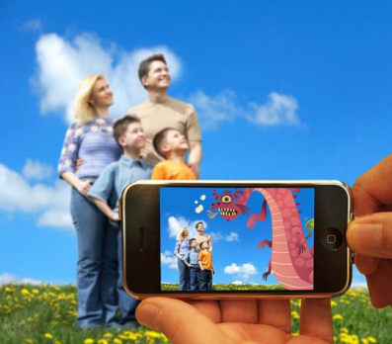
Augmented Reality
Modern Topics in Information Technology
4th Year – Semester 1
Lecture 02 - Part II
By Udara Samaratunge

Slide 2
Tracking system classification
Magnetic Trackers
Mechanical Trackers
Acoustic Trackers
Trackers using Vision
Indoor-Tracking system

Slide 3
Tracking Systems
Track user’s Body, Head, Hands and etc. Examples of tracking systems are mechanical, magnetic, acoustic and vision,
When track the user within the monitored area, the position, direction (orientation) of movement and the speed has to be determined.
Different techniques were developed to determine object position.
Relative Localization –
Evaluating the position and orientation by integrating information provided by diverse (usually encoder or inertial) sensors.
The integration is started from the initial position and is continuously updated
Absolute Localization -
Technique that permits the vehicle to determine its position in the domain of motion.
These methods usually rely on navigation beacons, active or passive landmarks, maps matching or satellite-based signals like Global Positioning System (GPS).

Slide 4
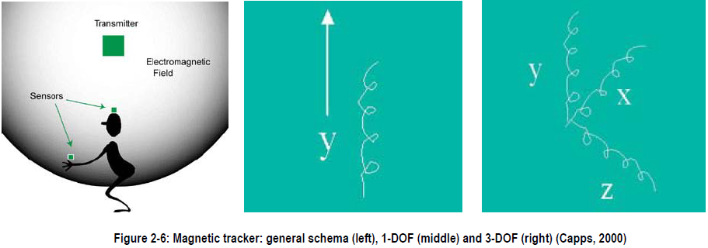
1. Magnetic Trackers.
Magnetic trackers are used to capture translation coordinates (x,y,z) and yaw, pitch, roll (y,p,r) rotation coordinates
Magnetic tracking is most commonly used as an interface to a virtual world, for instance, by tracking head, hand, or input device motion.
Some magnetic trackers can follow a number of devices simultaneously.
Magnetic tracking technology can be an option for full-motion body capture.
Real-time, perhaps to drive the motion of a virtual character, or can be recorded to give virtual actors realistic motion characteristics

Slide 5
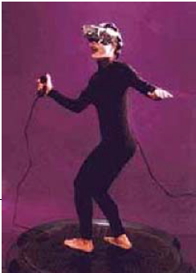
2. Mechanical Trackers
Mechanical position trackers, also known as goniometers or exoskeletons.
The exoskeleton must be physically attached to the user.
It can be body-based, user can freely move around.
These trackers uses couple of miniature gyroscopes to measure orientation changes.
This resistance can be measured, and converted into yaw, pitch, and roll values.

Slide 6
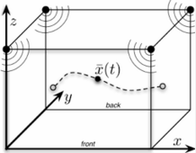
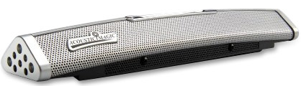
3. Acoustic Trackers
Acoustic tracking devices use ultrasonic (high-frequency)
Sound waves for measuring the position and orientation of the target object
Notes:
Disadvantages
Low update rate, resulting from the low speed of sound in air.
Affect environmental factors such as temperature, barometric pressure, and humidity to propagate sound in the air.

Slide 7
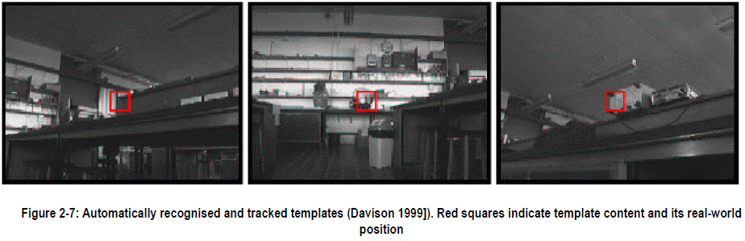
4. Trackers using vision
Vision is commonly used for AR tracking
Vision methods can estimate camera pose directly.
The position estimate is often relative to the object(s) of interest and not to a sensor or emitter attached to the environment.
Tracking may occur relative to moving objects;
Tracking measurements made from the viewing position often minimize the visual alignment error;
Tracking accuracy varies in proportion to the visual size (or range) of the object(s) in the image

Slide 8
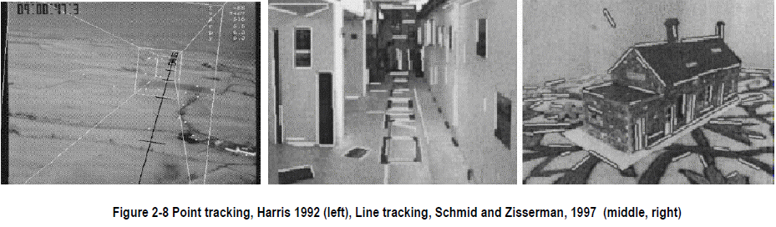
Features can be tracked using template, point, lines, corners, color and combinations of them.
Notes:
Template Tracking
popular for tracking the position based on a piece of real-world scenery.
Templates are small image patches that can be used over a wide range of camera positions.
Reliable templates can be extracted automatically and their position can also be estimated.
Point on an edge
known orientation is very fast, probably the first real-world camera tracking algorithm that could run in real-time on a standard desktop compute.
The original Harris paper already indicated an accuracy of 0.5% using photos taken from an airplane, which is of the same order as the feature tracking system.

Slide 9
Tracking Corners
E.g. crossings of lines, or gradient and curvature measurements can also be used to correct drift in their inertial tracking system using curvature corner detectors.
Matching those corners with a projection of stored geometry (You et al 1999).
Line matching
Kosaka and Nakazawa 1995
Use a 3D model of the environment and match lines from this database using a rough transform of the image.
They reach sub-centimeter accuracy and 1degree orientation accuracy when the distance to a feature is about 20 cm.
Color
Powerful means to enhance tracking robustness.
Color tracking is still not very well explored, perhaps due to the fact that colors are highly invariant.
When the user moves around or lighting conditions change.

Slide 10
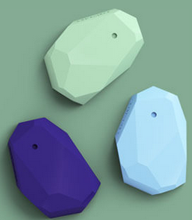
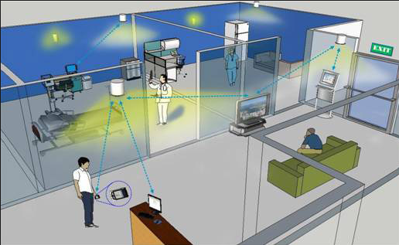
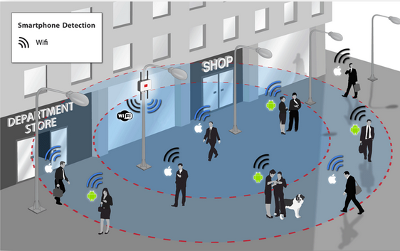
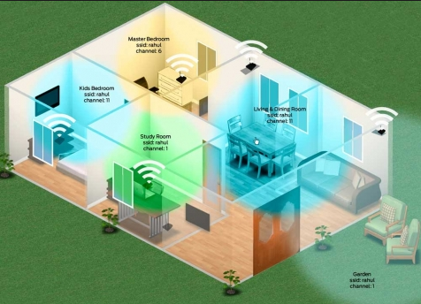
5. Indoor Tracking System

Slide 11
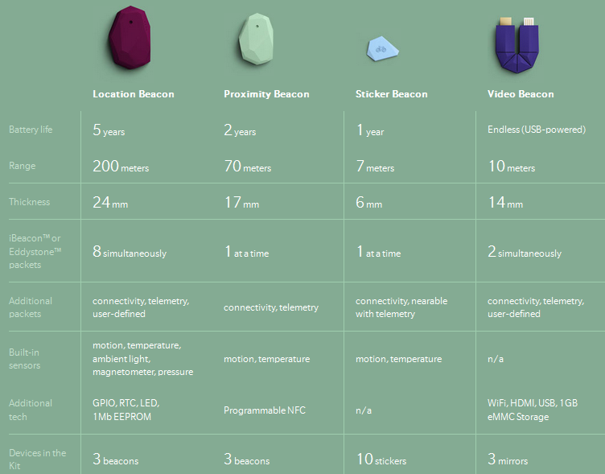
Usage of Beacons

Slide 12
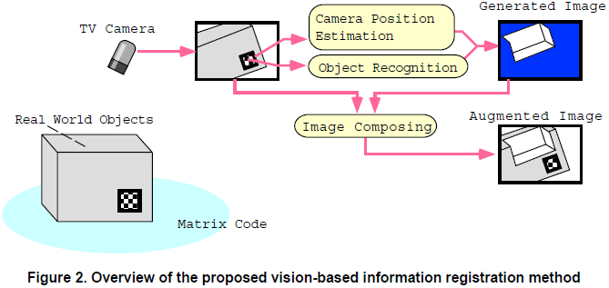
A Real-time Object Identification & Registration for AR
AR systems normally measure the position and orientation of a device with 3D sensors (either magnetic or ultrasonic);
By analyzing the distortion of the rectangular shape of the matrix code frame, the system estimates the position and orientation of the video camera.

Slide 13
Steps in Recognition Algorithm
Binarization
Connected Component Analysis
Code Frame Fitting
Decoding and Error Check
Camera Position and Pose Estimation

Slide 14
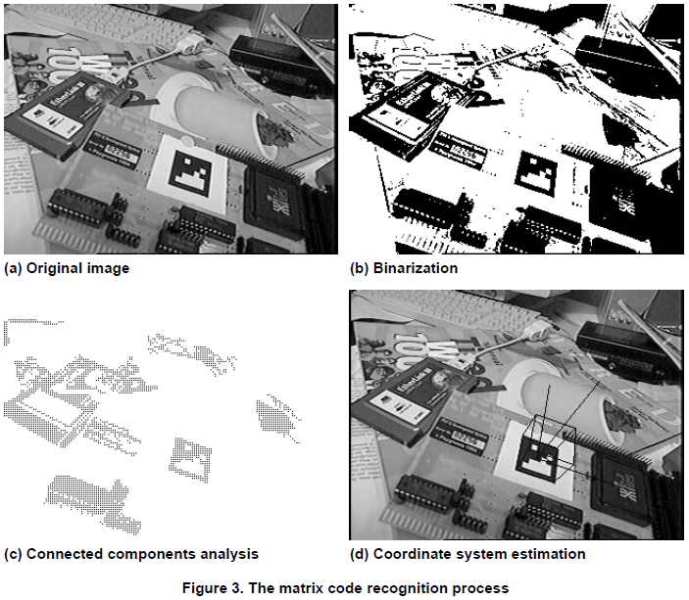
Binarization
Image binarization converts an image of up to 256 gray levels to a black and white image.
Thresholding is the simplest method of image segmentation. From a grayscale image, thresholding can be used to create binary images.
The simplest thresholding methods replace each pixel in an image with a black pixel if the image intensity I{i,j} is less than some fixed constant T=> (I{i,j} < T)
Notes:
Image binarization converts an image of up to 256 gray levels to a black and white image. Frequently, binarization is used as a pre-processor before OCR. In fact, most OCR packages on the market work only on bi-level (black & white) images.
The simplest way to use image binarization is to choose a threshold value, and classify all pixels with values above this threshold as white, and all other pixels as black. The problem then is how to select the correct threshold. In many cases, finding one threshold compatible to the entire image is very difficult, and in many cases even impossible. Therefore, adaptive image binarization is needed where an optimal threshold is chosen for each image area.
Follow the link here for some examples of interesting gray level images, and the results of our use of adaptive binarization.

Slide 15
Connected Component Analysis
Connected regions => binary-1 (black) pixels.
Identify connected region
heuristic check (based on the size and the aspect-ratio of the region bounding rectangle).

Slide 16
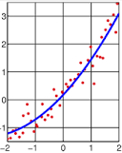
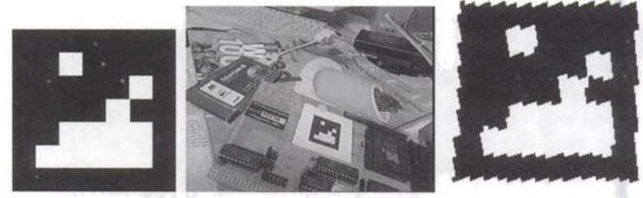
Code Frame Fitting
For each selected region a rectangle is fitted on the outline of region using least-square method.
Then, transformation parameters are calculated based on the positions of the 4 corners of this quad-tangle.
Then Distortion-compensation matrix is calculated based on the 4 corners of quad-tangle.

Slide 17
Decoding & Error check
Using the obtained parameters, the system projects the corresponding image region to the code rectangle space.
The number of black and white pixels => determine cell bit (1,0)
Finally, the CRC-error check is applied on the decoded bit Pattern
And the certificated cell value is regarded as a recognized code ID.
Notes:
A CRC is called an n-bit CRC when its check value is n bits long. For a given n, multiple CRCs are possible, each with a different polynomial. Such a polynomial has highest degree n, which means it has n + 1 terms. In other words, the polynomial has a length of n + 1; its encoding requires n + 1 bits. Note that most polynomial specifications either drop the MSB or LSB, since they are always 1. The CRC and associated polynomial typically have a name of the form CRC-n-XXX as in the table below.

Slide 18
Camera Position and Code Estimation
The recognized code frame is used for camera pose estimation.
From 4 known points on the (real-world) image plane
It is possible to calculate a matrix representing the translation and rotation of the camera at a real-world coordinate.
We use 4 corners of the 2D-code frame as these reference points.

Slide 19
Tools, Techniques and Approaches

Slide 20
Tools, Techniques and Approaches
Identifying and selecting the appropriate tools that are going to be implemented during the Augmented Reality project.
Platform Comparison
Platform | Price of development | Equipment owned | Ability to create AR apps
iOS | Positive – X-Code is free Negitive - £90 development license | Positive - iPod Touch - Mac provided by university | Yes
Android | Positive - Android Studio is free - No developer license required | Positive - Laptop capable of running Android Studio Negative - HTC One Android Device incompatible with Android Studio | Yes

Slide 21
Tools, Techniques and Approaches cont.
Platform | Price of development | Equipment owned | Ability to create AR apps
Windows | Positive -Visual Studio Express 2013 free basic version Negative - Pay for full version of visual studio | Positive - Laptop capable of running Visual Studio Negative - No mobile device owned | Yes
BlackBerry | Positive - Momentics is free - Developer license free | Positive Laptop capable of running Momentics Negative - No mobile device owned | Yes

Slide 22
Integrated Development Environments (IDE)
IDE | Capability with Equipment | Developer Experience | Price | Capability with an independent AR SDK | Online Tutorials and Videos
X-Code | Yes | Positive - Beginner (3 months experience) | Free | Positive - Yes numerous | Positive - Lots, University paid subscription to Lynda.com
Unity | Yes | Positive - Beginner (previous project) | Free (Basic version) | Positive - Yes numerous | Positive - Lots

Slide 23
IDE | Capability with Equipment | Developer Experience | Price | Capability with an independent AR SDK | Online Tutorials and Videos
Visual Studio with Marmalade SDK | Yes | Positive - Moderate (2 Years) | Free | Positive - Yes numerous | Positive - Lots, University paid subscription to Lynda.com
DAQRI 4D | Yes | Negative - None | Negative Paid - £440 month is the cheapest | N/A Dedicated AR Studio | Negative - Minimal
Aurasuma Studio | Yes | Negative - None | Free | N/A Dedicated AR Studio | Negative - Minimal
Metaio Creator | Yes | Negative - None | Free (Basic version) | N/A Dedicated AR Studio | Negative - Minimal
Layar | Yes | Negative - None | Free | N/A Dedicated AR Studio | Negative - Minimal

Slide 24
Augmented Reality SDKs
AR SDK | Price | Compatibility with iOS/X-Code | Developer Experience | Online Support
Metaio | Positive - Free (Watermarked) | Yes | None | Positive - Lots of Documentation - Metaio HelpDesk - Numerous Tutorials
Wikitude | Positive - Free | Yes | None | Positive - Lots of Documentation
Vuforia | Positive - Free (Watermarked) | Yes | None | Positive - Lots of Documentation - Numerous Tutorials Negative - Majority tutorials are for Unity

Slide 25
Feature Comparison
 | Vuforia | Metaio | Wikitude
Marker | Frame makers, image target, text target | ID, picture and LLA marker, QR and Barcode | Image, Barcode tracking
GPS | No | Yes | Yes
IMU | No | Yes | Yes
Face | No | Yes | No
Natural Features | Yes | Yes | Yes
3D Objects | Yes | Yes | No
Others | Extended tracking, localize occlusion detection | Instant 3D maps tracking, 3D SLAM, extended image tracking | Hybrid tracking (Image and GPS), extended tracking
Marker Generation | Online Target Manger | No online tool Provides ready made 512 different ID Markers | Online target manager tool

Slide 26
Feature Comparison Cont.
 | Vuforia | Metaio | Wikitude
Benefits | Enable to maintain tracking even when the target is out of view and view them from greater distance. Cloud Database allows storing thousands of image targets. | Powerful 3D rendering engine with capability load 3D model of .obj format. No limit on number of trackable object depends on device memory. | AR content can be programmed using basic HTML5, JavaScript and CSS. Easy portability of AR apps from one platform to another.
Limitations | Majority of Tutorials for the Unity platform | Difficult to render complex 3D objects also limitation is associated with model size. | Doesn’t track 3D model which limits is use to only 2D tracking. Target image to track need to be of solid colors to be recognized

Slide 27
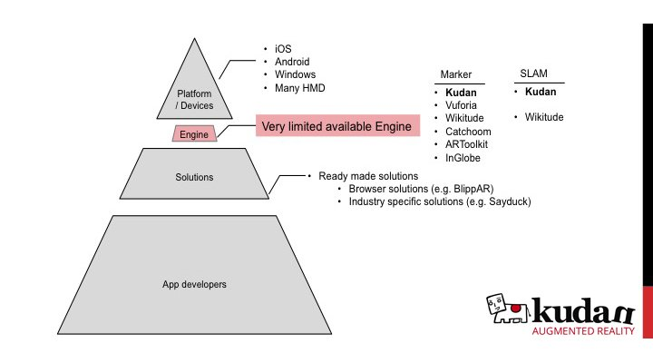
Existing Technologies for Augmented Reality

Slide 28
Comparison
 | Advantages | Disadvantages | Potential Concepts Uses
Marker Based (QR, Image) | - Simple to implement (AR Standard for visual applications - Cheap in terms of processing power | - Limited range (the distance from tracer to device) - Tracking challenges; unfocused camera, dark/unevenly lit environments, image noise (poor lens, block compression), occlusion (tracker and environment blending) - Usually works only when fully in view | - Laser Quest App - Chemistry App
Assisted GPS | - Augmentation can dynamically change depending where the user is | - Signal blocking (trees, buildings, mountains, indoors) - Inaccuracy/ Bad data from satellites (misreporting their own position) | - Which Plane? - Laser Quest App - History App - Runner Heart Rate App
Face Recognition |  | - New - Difficultly remembering/recognizing different faces | - Facebook App
Natural Feature | - Works if partially viewed - Targets are potentially everywhere - targets may catch attention less (blend into the environment) | - More difficult, markers are designed for their purpose, the natural environment is not | - Braille App

Slide 29
What is not Augmented Reality & Rejected Ideas

Slide 30
What is and what is not Augmented Reality?
All the ways of doing augmented reality have a common point: The mix of reality and virtual.
What is not augmented reality?
For example, some cities provide QR Codes, which redirect to a website if you point at it with a smartphone. In these projects, QR Codes are placed on famous buildings and places, and the website you are redirected to explains you the building history, and some other extra information.
This kind of project is not augmented reality, because it does not mix this extra information with the reality, it just links it.
Again, in augmented reality applications, reality and virtual have to be mixed.

Slide 31
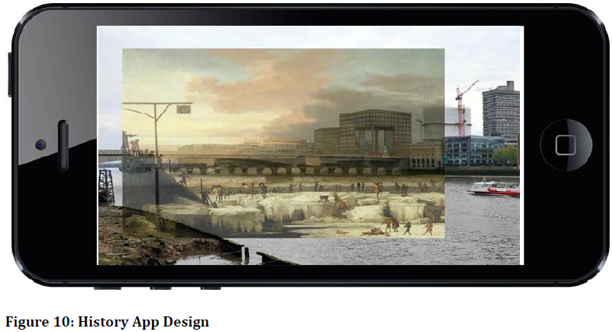
Rejected ideas in Augmented Reality
History App design
It was rejected because the concept wasn’t stressing the boundaries of AR, and the concept resembled a 2D overlay more than AR application a user could interact with.
Azuma (1997) stated 2D overlays could not be AR because the user interact with it, therefore this concept was rejected.

Slide 32
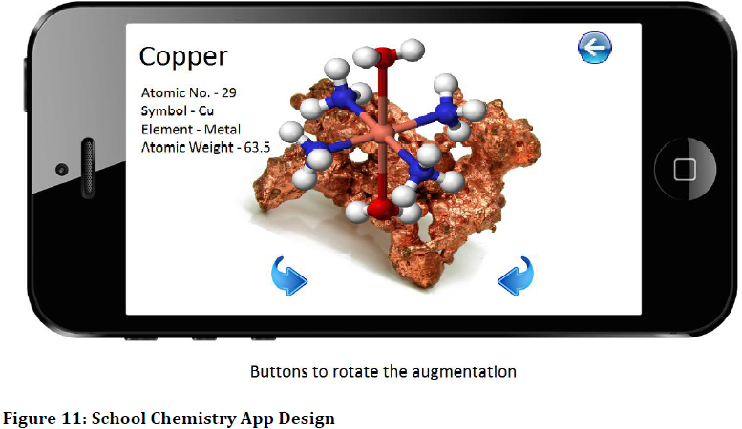
School Chemistry App
While looking at future uses of AR, education is one of those areas AR could expand into.
This was the first concept created as part of this project but in the end it was rejected because the idea acts in a similar way to a vast amount of AR, Where simply the user scans an image and a virtual object appears.

Slide 33
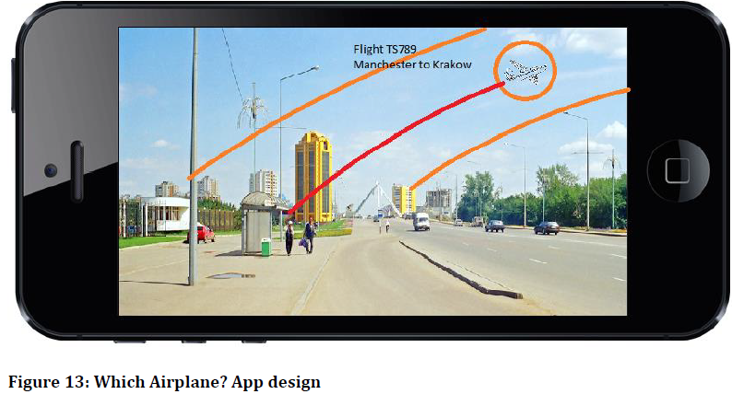
Air Plane details APP
Using flight data from sources such as flightaware.com the user would be able to track airplanes in the sky by holding their device towards the plane in the sky.
The app would highlight the plane in the sky and display detail such as, which flight it was, departure/arrival locations, flight path, flight boundaries, and flight delay.

Slide 34
Drawbacks and Limitations

Slide 35
Drawbacks & Limitations in Augmented Reality
Accuracy
When it comes to accuracy, currently the margin of error is large.
For example, it is 10 meters on today's GPS systems and when you're trying to superimpose an image on another at close range, that is not accurate enough
Standards
No open standards among Augmented Reality browsers
Availability of Augmented Reality -capable devices
Smart Phones only due to availability of hardware components (GPS, camera, compass, 3D rendering capability, and more)
It is not that natural to walk with your phone camera pointing everywhere.
Some tools exists to avoid this problem such as augmented reality glasses (e.g. 3D Visors)

Slide 36
References
http://wp.nmc.org/horizon2010/chapters/simple-augmented-reality/ Retrieved September 25, 2010.
http://www.bing.com/images/search?q=Augmented+reality+pictures&FORM=IGRE&qpvt=Augmented+reality+pictures. Retrieved October 9, 2010
http://www.bing.com/images/search?q=Augmented+reality+pictures&FORM=IGRE&qpvt=Augmented+reality+pictures Retrieved October 9, 2010.
http://www.howstuffworks.com/augmented-reality.htm
Retrieved October 7, 2010.
http://www.britannica.com/EBchecked/topic/1196641/augmented-reality
Retrieved October 7, 2010.
http://www.bing.com/images/search?q=Augmented+reality+pictures&FORM=IGRE&qpvt=Augmented+reality+pictures.# Retrieved October 13, 2010.
http://www.newhorizons.org/strategies/technology/billinghurst.htm
Retrieved October 7, 2010.

